Slide 1

Virtual Art Slide Show
We would like to welcome everyone to our Art show. This show is of the mindful colouring in that all students and staff have created since we began lockdown at the end of March.
Please enjoy.

Slide 2
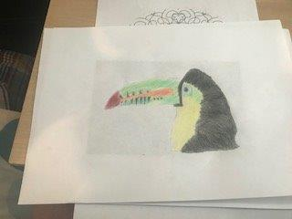
Toucan by Thomas
Thomas printed out a picture and copied it very carefully using fine colouring pencils. Matching the colours perfectly.

Slide 3
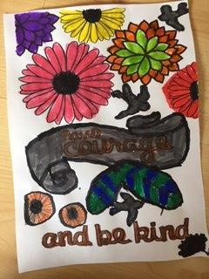
Have Courage and be Kind by Carys
A lovely sentiment that we are all currently living by, this picture has been created by using bright colourful felt tip pens and shows the lettering with flowers and birds around them.

Slide 4
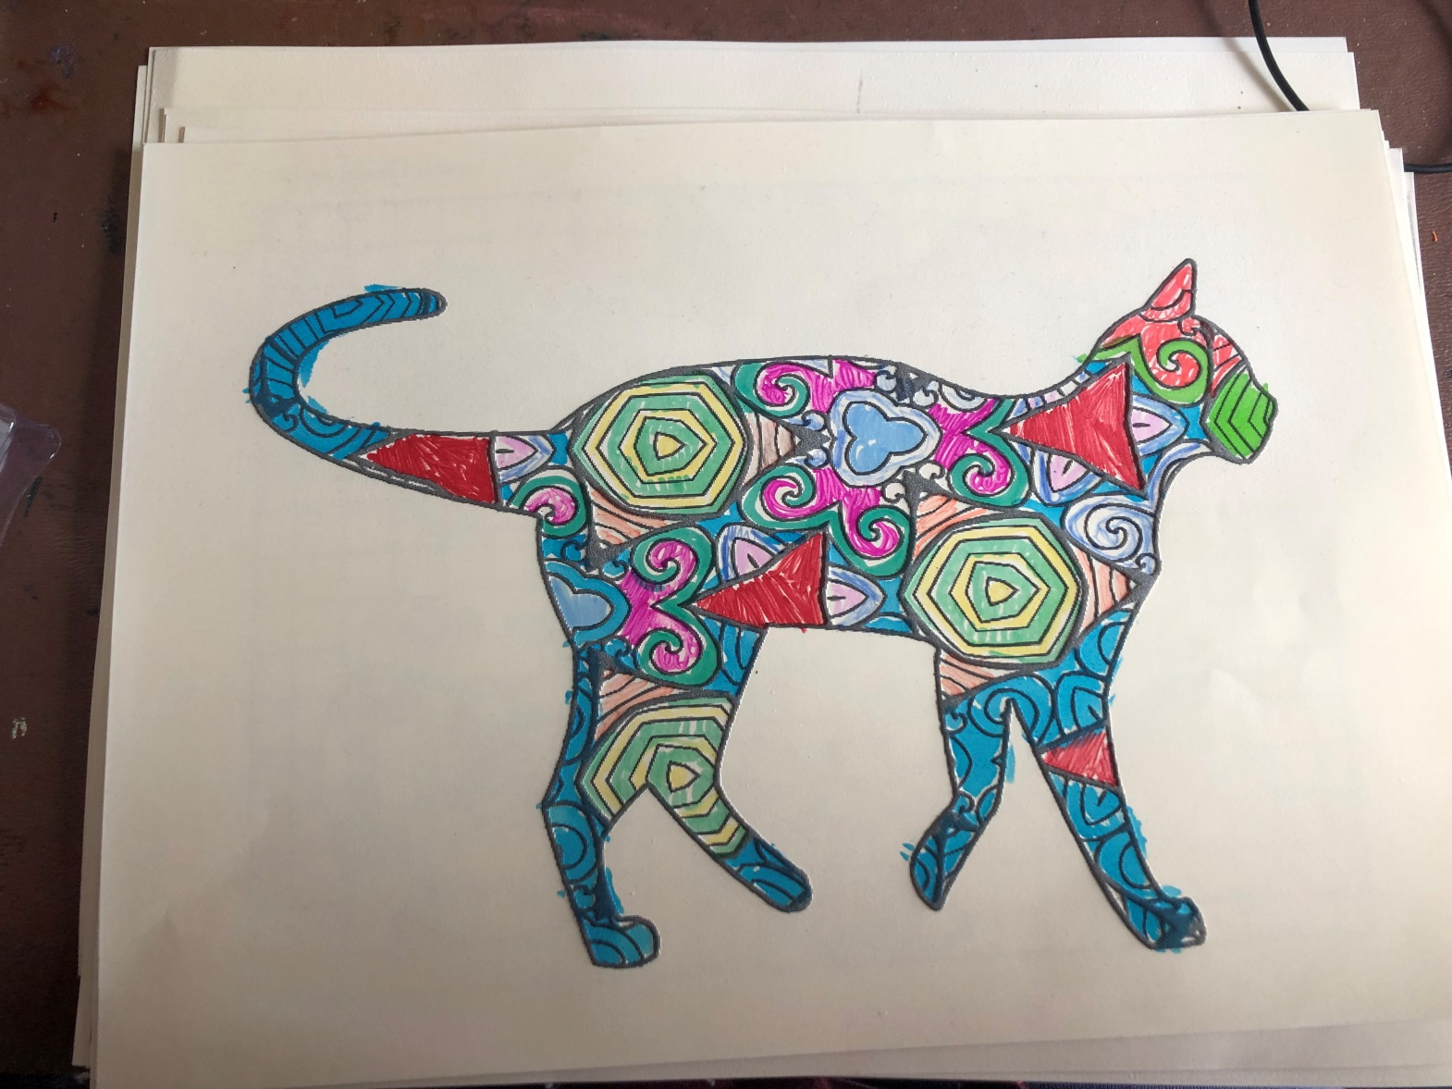
Cat by Amy
Not your usual Tabby cat , lovely bright felt tip pens have been used to create this one.

Slide 5
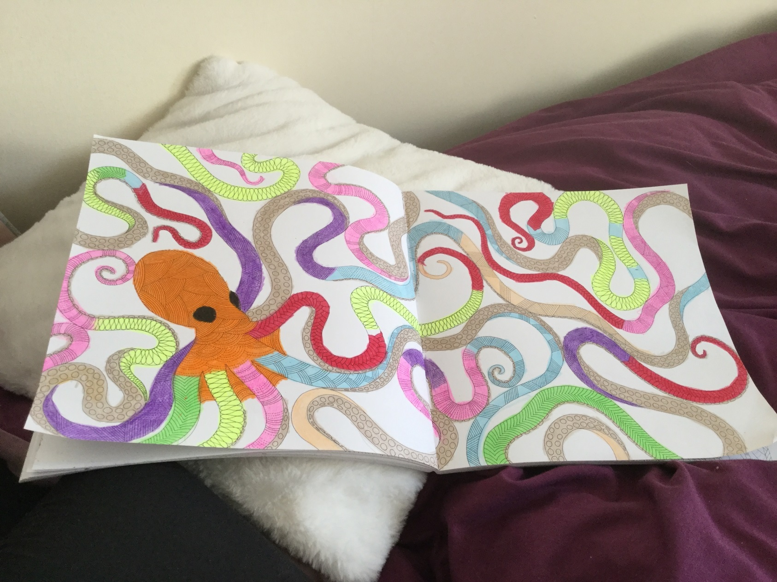
Octopus by Hannah
A very brightly coloured orange octopus with long reaching tentacles stretching over the pages, twisted together.

Slide 6
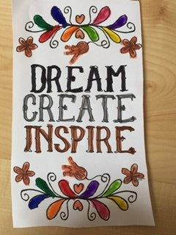
Dream, Create, Inspire by Carys
Hopefully a saying that really inspires all. Beautifully coloured in with water colours, bright and happy.

Slide 7
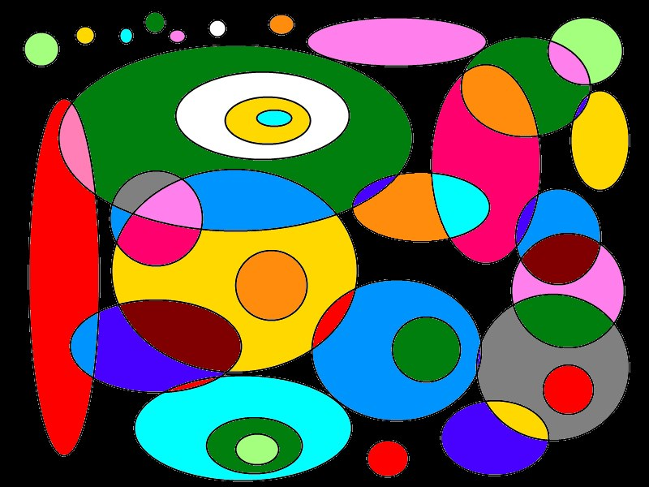
Dotty or Spotty
A Paint. Net picture here, lots of brightly coloured circles and ellipses, different sizes overlapping each other creating dots or spots you decide.

Slide 8
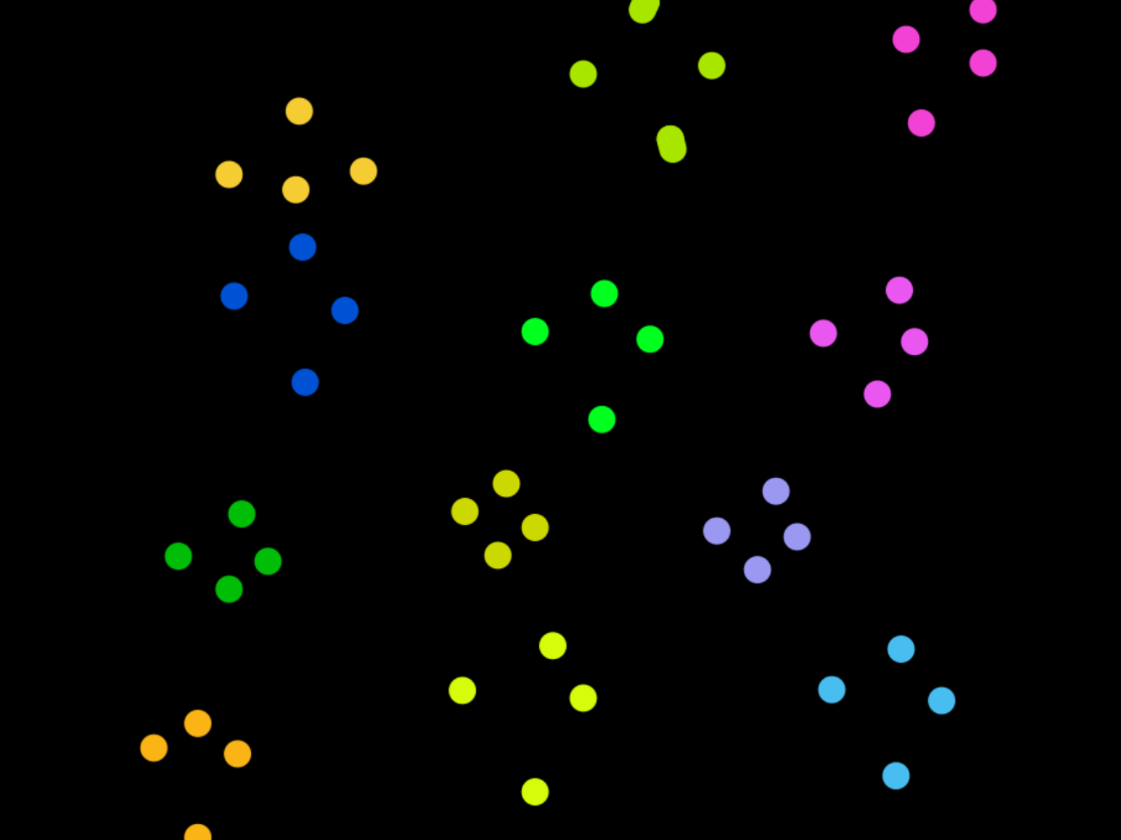
Colourful Dots by Max
Almost like stars in the sky, Max has created this using an App on his iPad called Doodle. Groups of four dots spread over a black back ground.

Slide 9
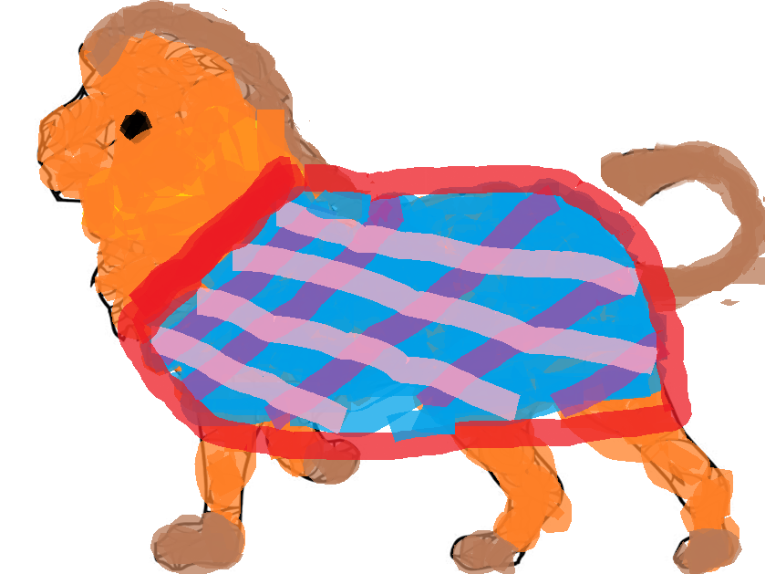
Roar by Carys
A very majestic lion carrying a brightly coloured robe over his back. This was created using paint. A very fierce creature.

Slide 10
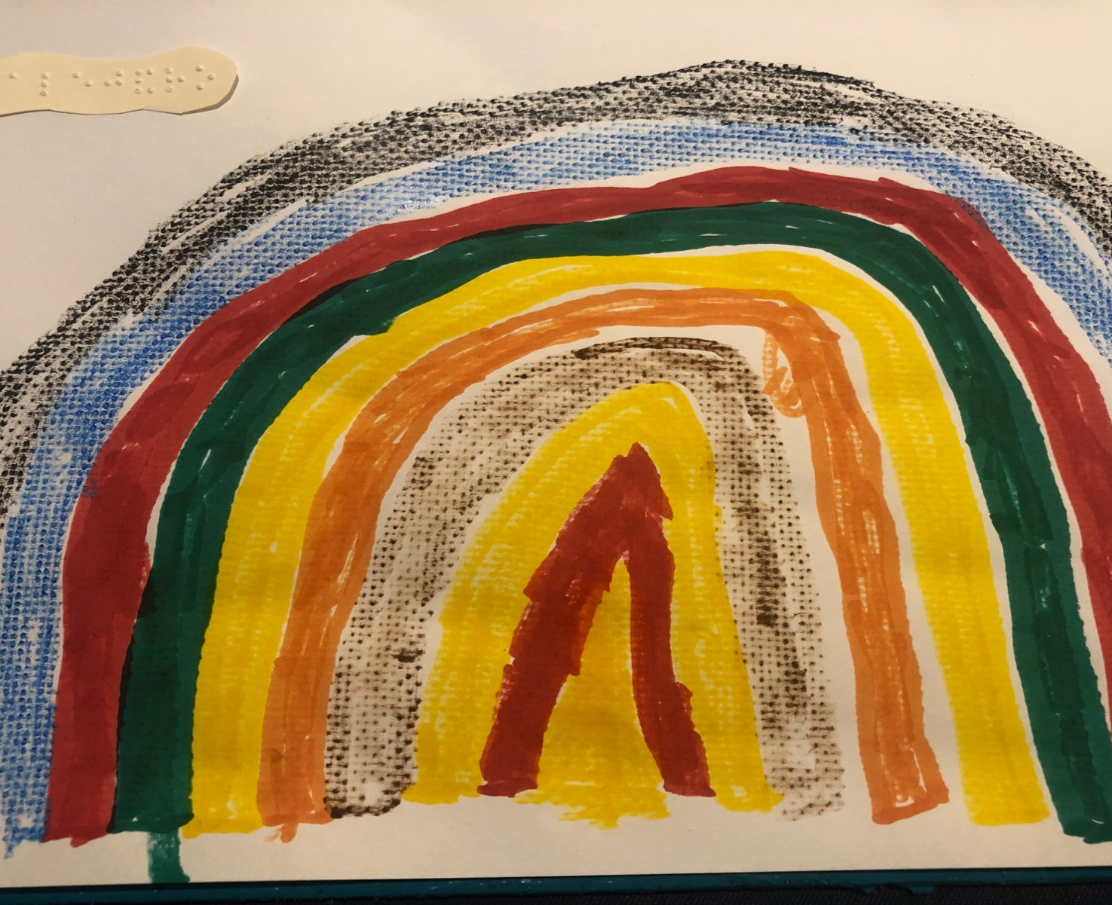
Rainbow by Alejandro
A textured rainbow using mixed media in bright brilliant colours, with added Braille.

Slide 11
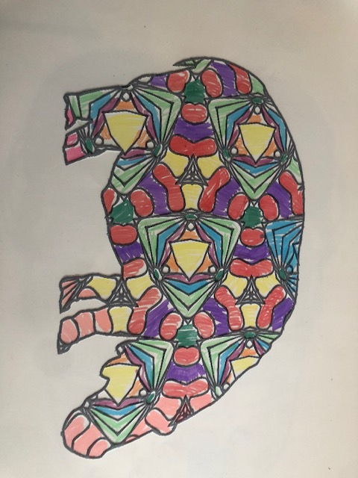
Hippo by Amy
A rainbow coloured hippo which may have been in water and sunshine combined . Very decorative .

Slide 12
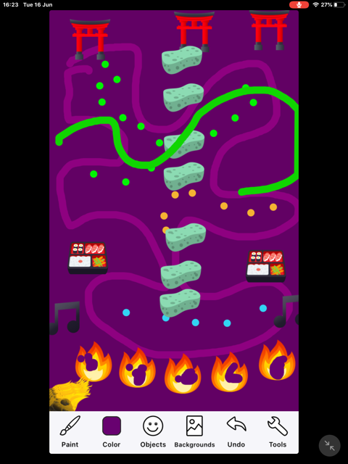
Japanese Inspiration by Max
We have sushi, pagodas , fire and sponges in this creation all on a purple background.

Slide 13
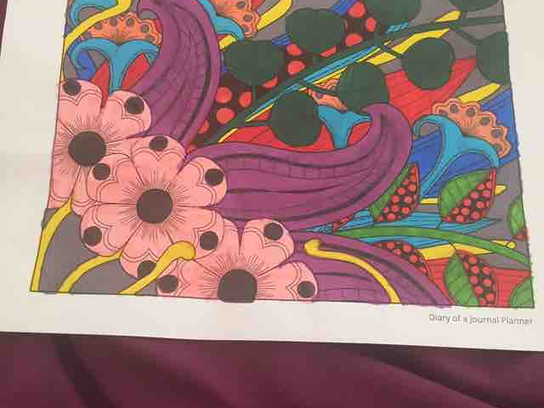
Flowers by Hannah
Gorgeous shades of pinks and purple flowers in the foreground with bright primary colours at the back.

Slide 14
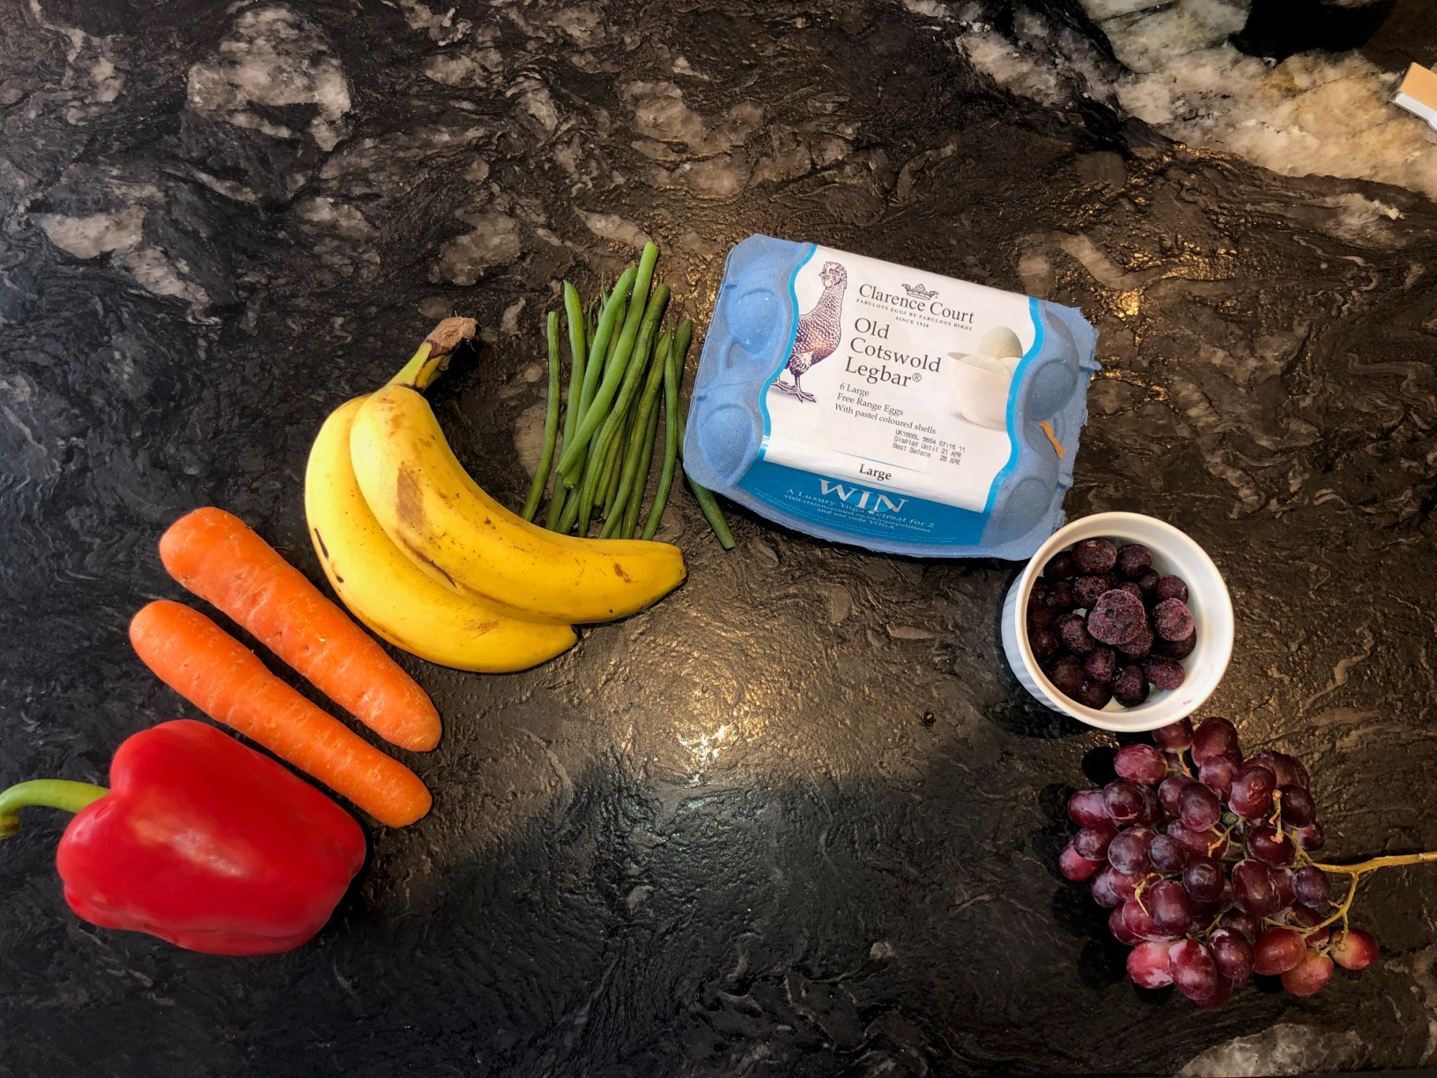
Rainbow by Jack
Why colour a rainbow when all the colours can be found in the food you eat. A fantastic range of healthy choices were used to create this rainbow.

Slide 15
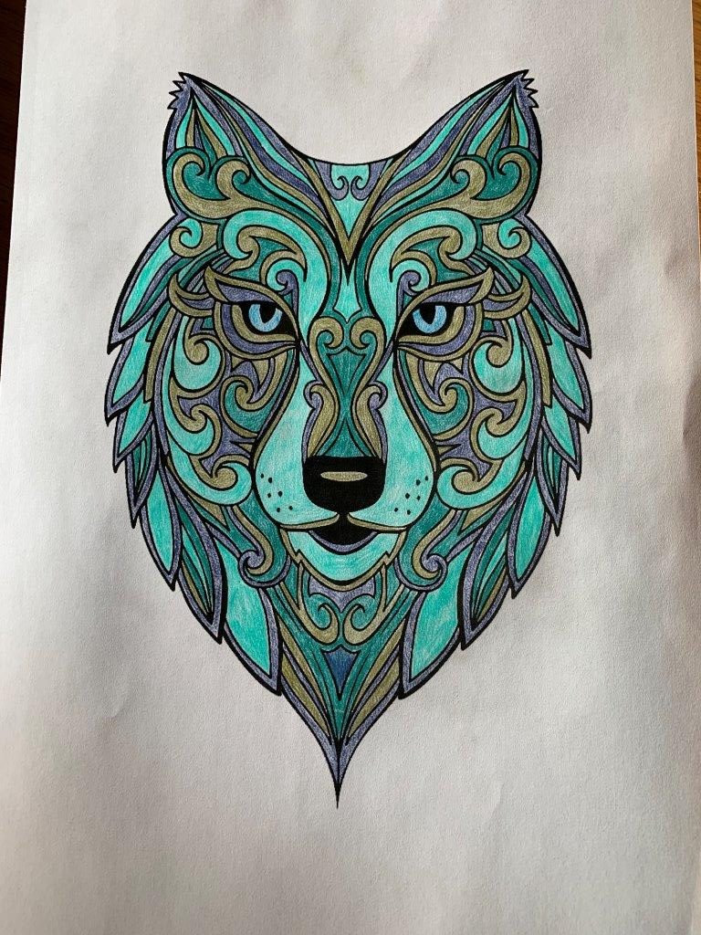
Blue Wolf by Mrs Pratt
A steely looking beast is watching you. Gorgeous shades of blue has been used here with touches of grey and silver.

Slide 16
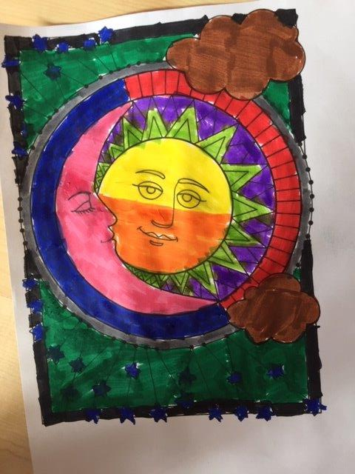
Moon and Sun by Carys
Cool and warm shades in water colour paint have been used in this picture.

Slide 17
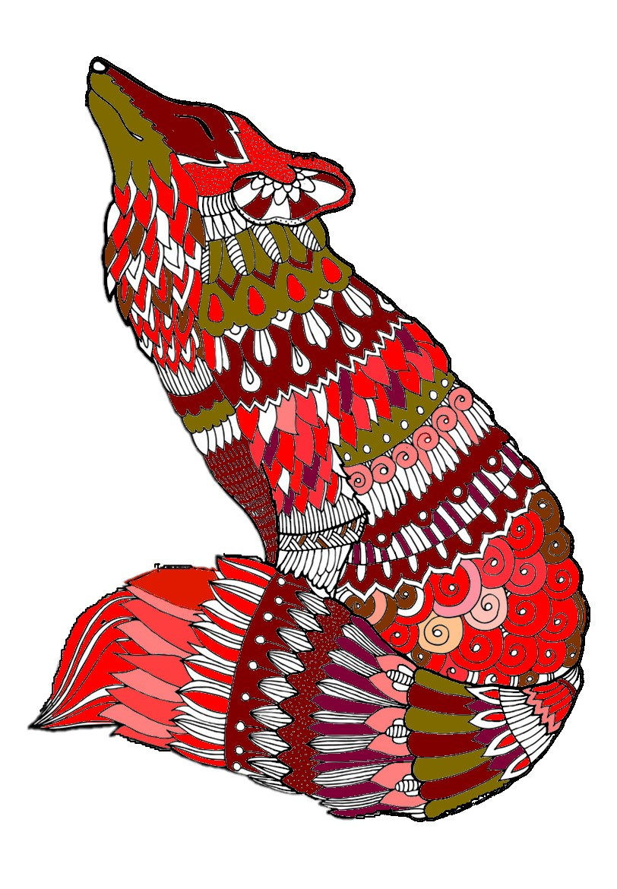
Foxy Loxy by Mrs Kings
With the news that the wildlife have taken back parts of the college’s grounds the theme seemed very appropriate. Bright oranges, browns, coral colours and even pink were used in the patterns on this fox.

Slide 18
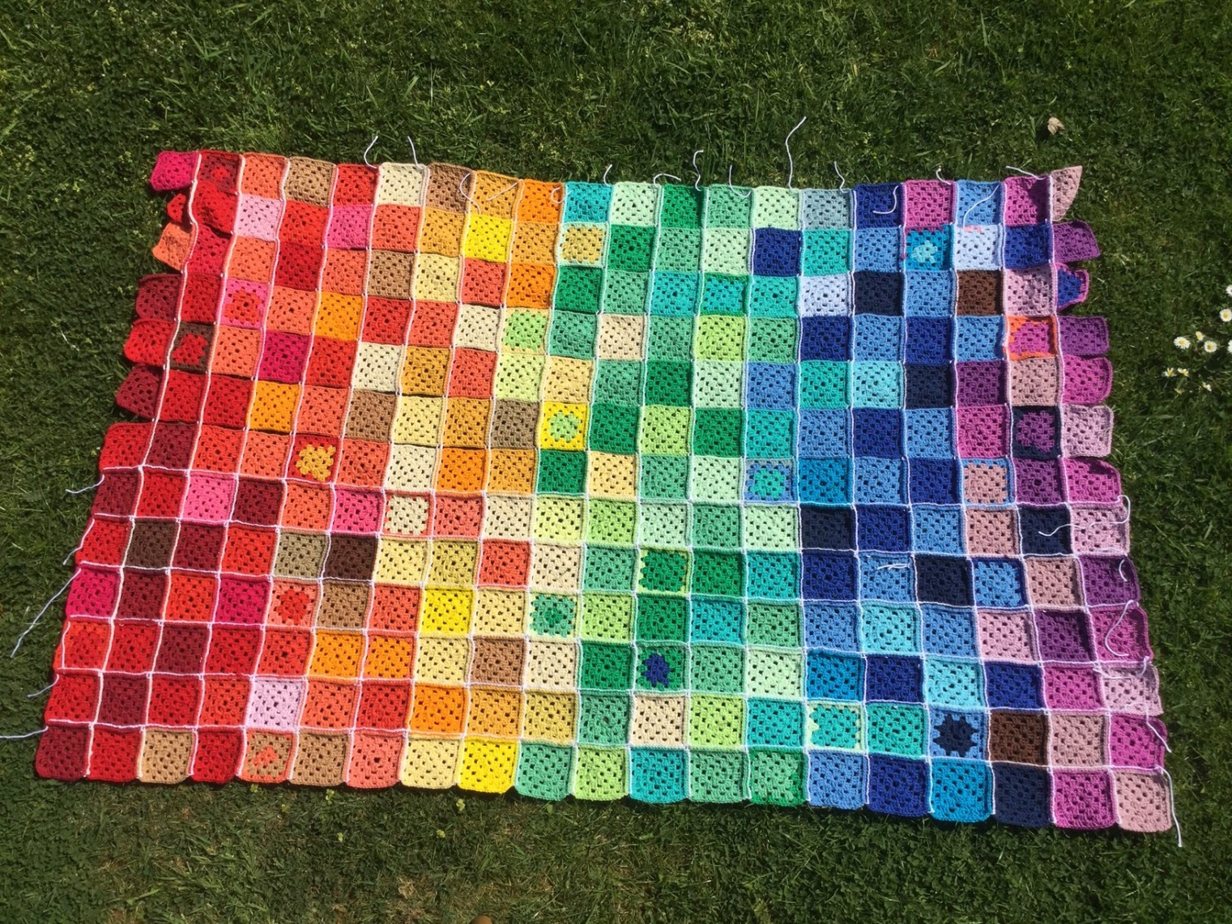
Patch work rainbow by Mrs Wright
A fantastic crocheted patchwork, an absolute riot of colour.

Slide 19
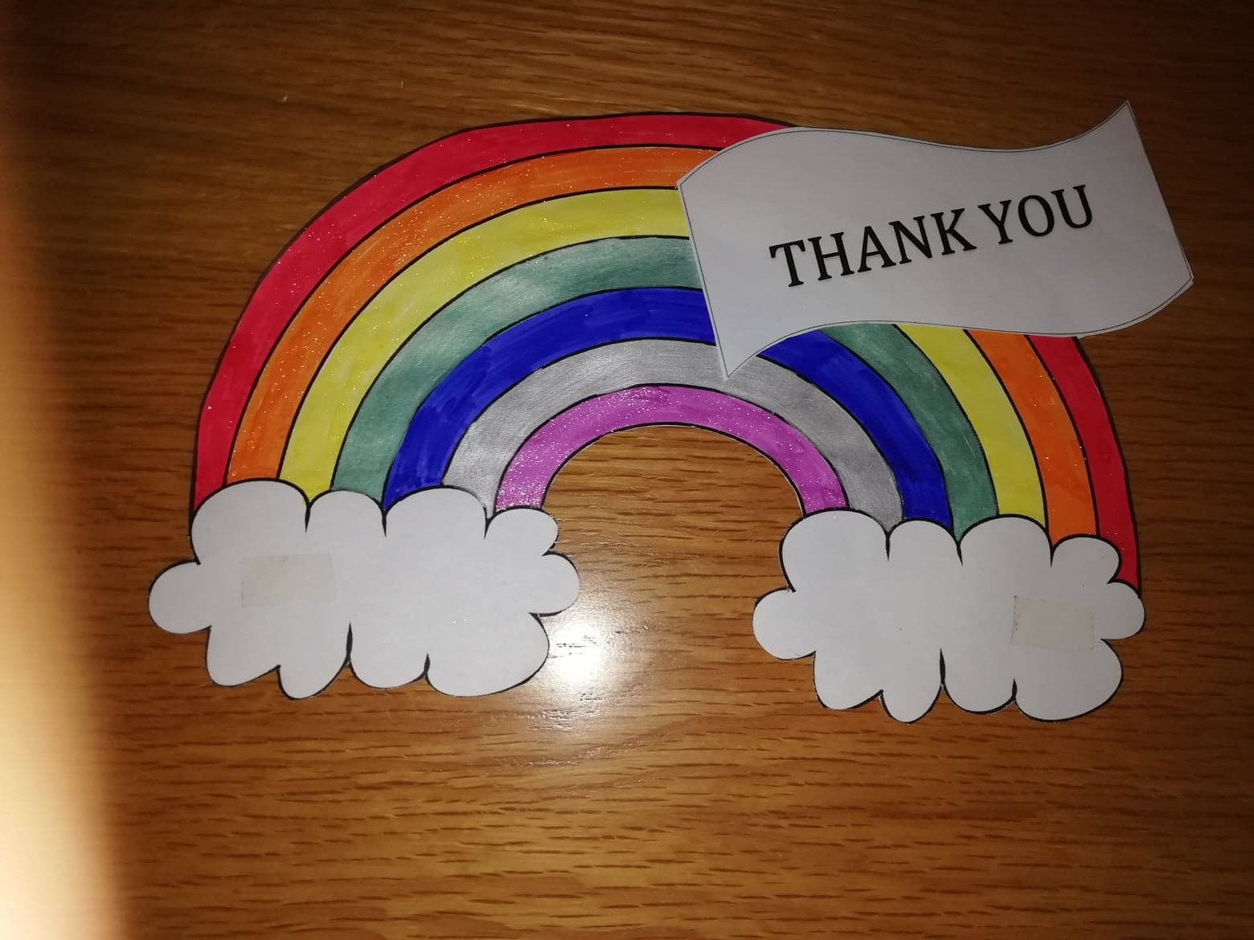
Thank you Rainbow by Mrs Martin
As part of our thank you to the NHS rainbows were created and this one shows bright colours with a hint of metallic sparkle.

Slide 20
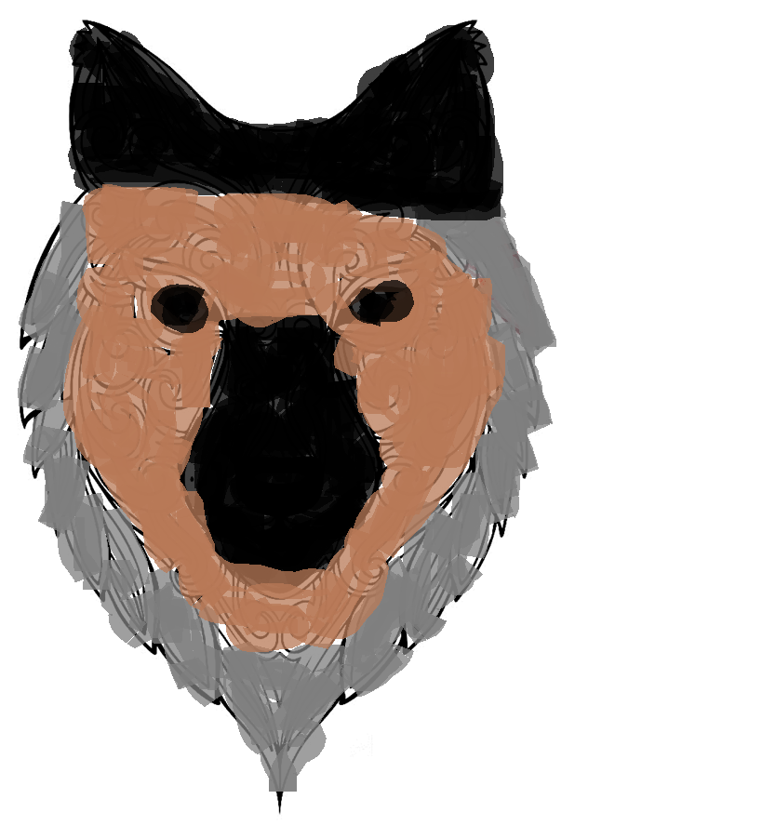
Wolfy by Carys
This resembles the mascot for Worcester basket ball team, Worcester Wolves, who some of our students have been following.

Slide 21
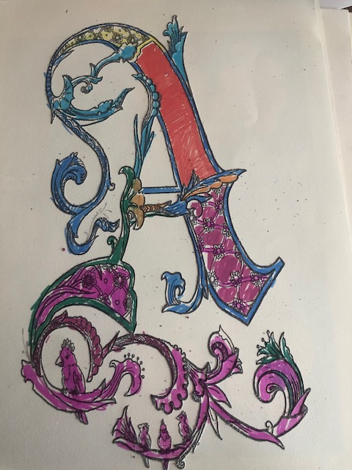
Illuminated Letter by Amy
In shades of red and purple this initial would look good in manuscripts of old.

Slide 22
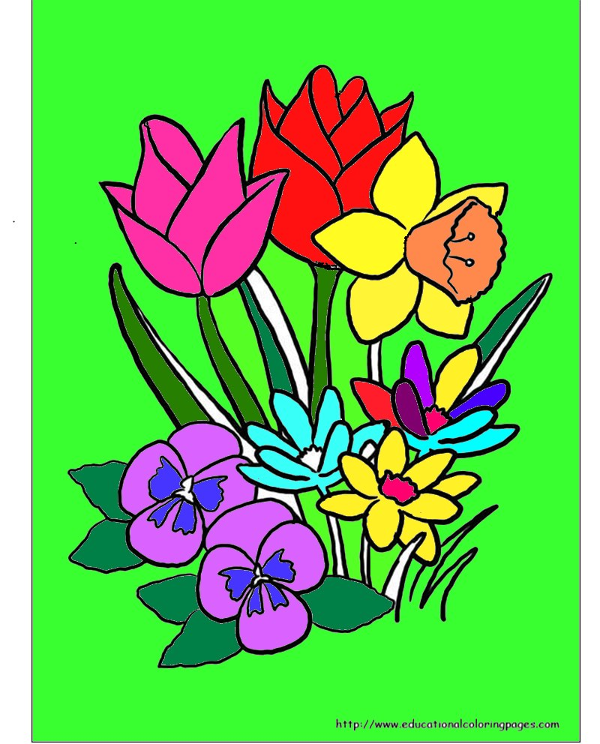
Spring has sprung
Spring has sprung and what a beautiful one we had, lovely weather, nature coming to the fore and flowers blooming.

Slide 23
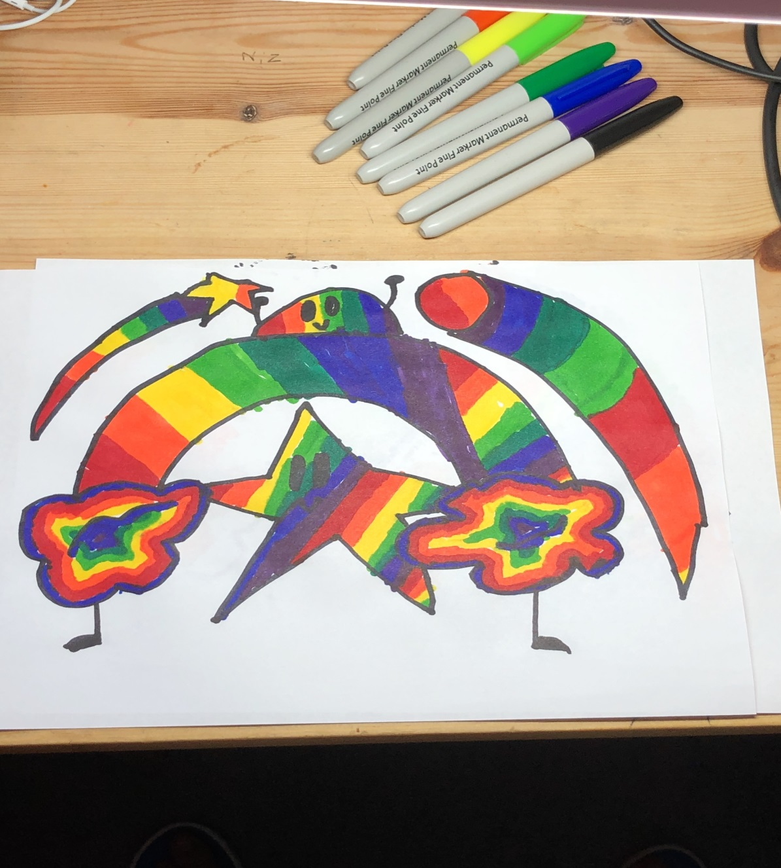
Rainbow Explosion by Khadija
A collection of shapes including star, arches and cloud, all coloured in in a wonderful array of bright colours.
Red, orange, yellow, green and blue not forgetting purple!

Slide 24
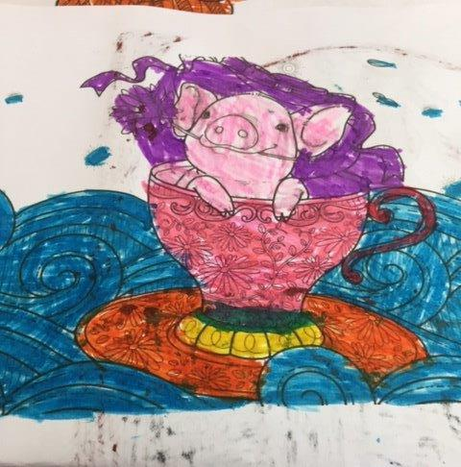
Pig in a Tea Cup by Carys
Nothing to say but cute! Where else would you find a pig? This picture just makes you smile.

Slide 25
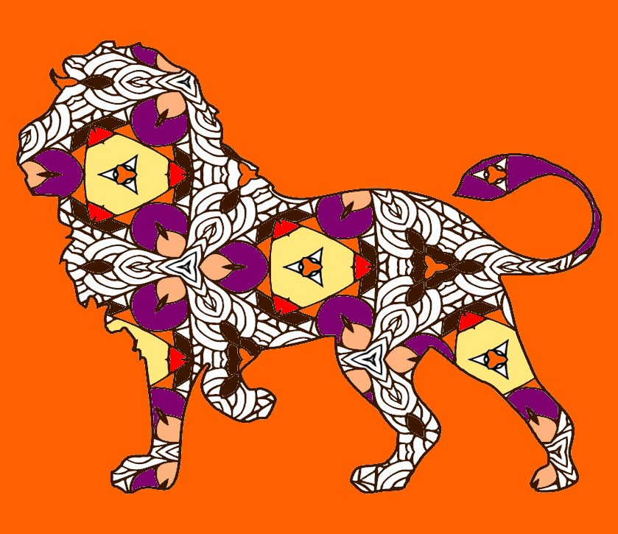
Regal Lion
Another Paint. Net creation, a proud lion using 70’s style colours of orange, brown and purple shades.

Slide 26
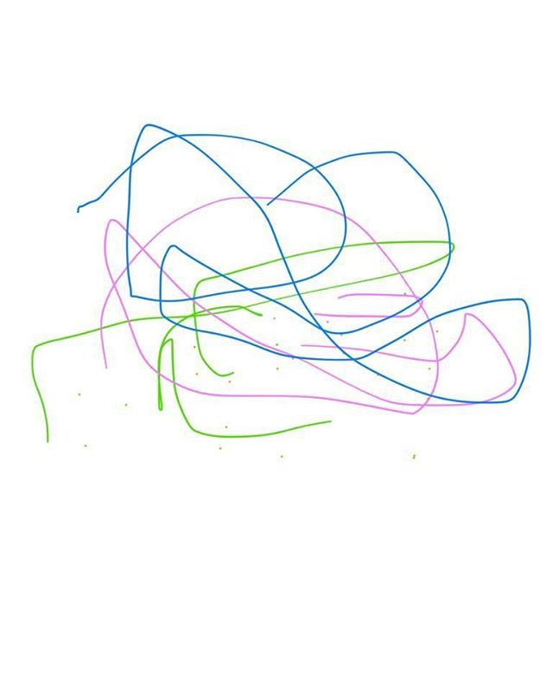
Abstract by Eben
Using three different coloured lines to create waves and circles overlapping each other.

Slide 27
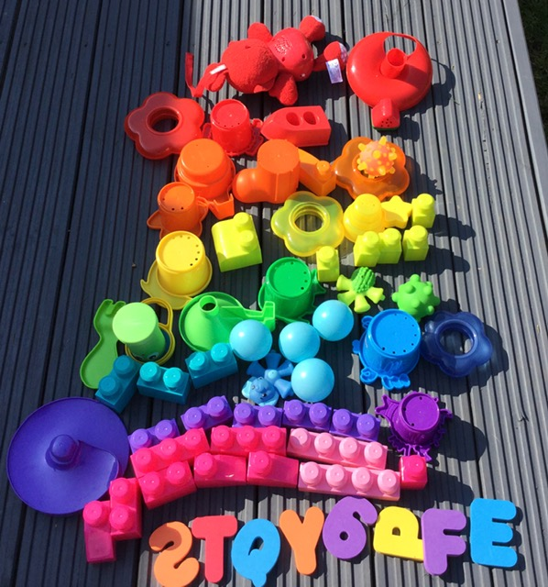
I Found a Rainbow by Max
Using some of his sisters toys Max ‘s creativity has come to the fore here, it is definitely something we would put on the wall.

Slide 28
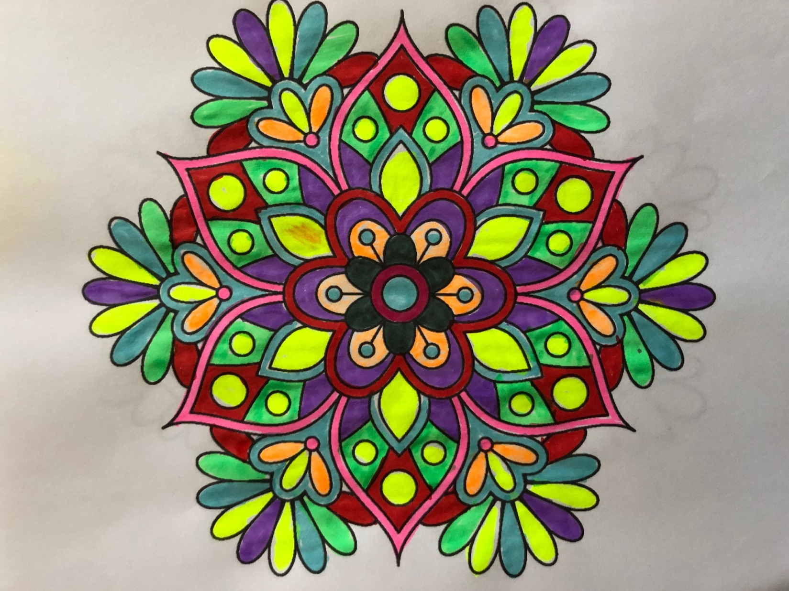
Mandala by Mrs Phillips
A wonderful flower mandala , using bright neon yellow with red, green touches of pink.

Slide 29
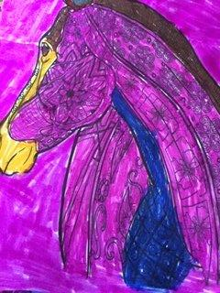
Purple Mare by Carys
With Carys’ love of horses it’s no surprise that she chose to colour this one in, the biggest surprise the use of Purple! With touches of complementary yellow and a little blue.

Slide 30
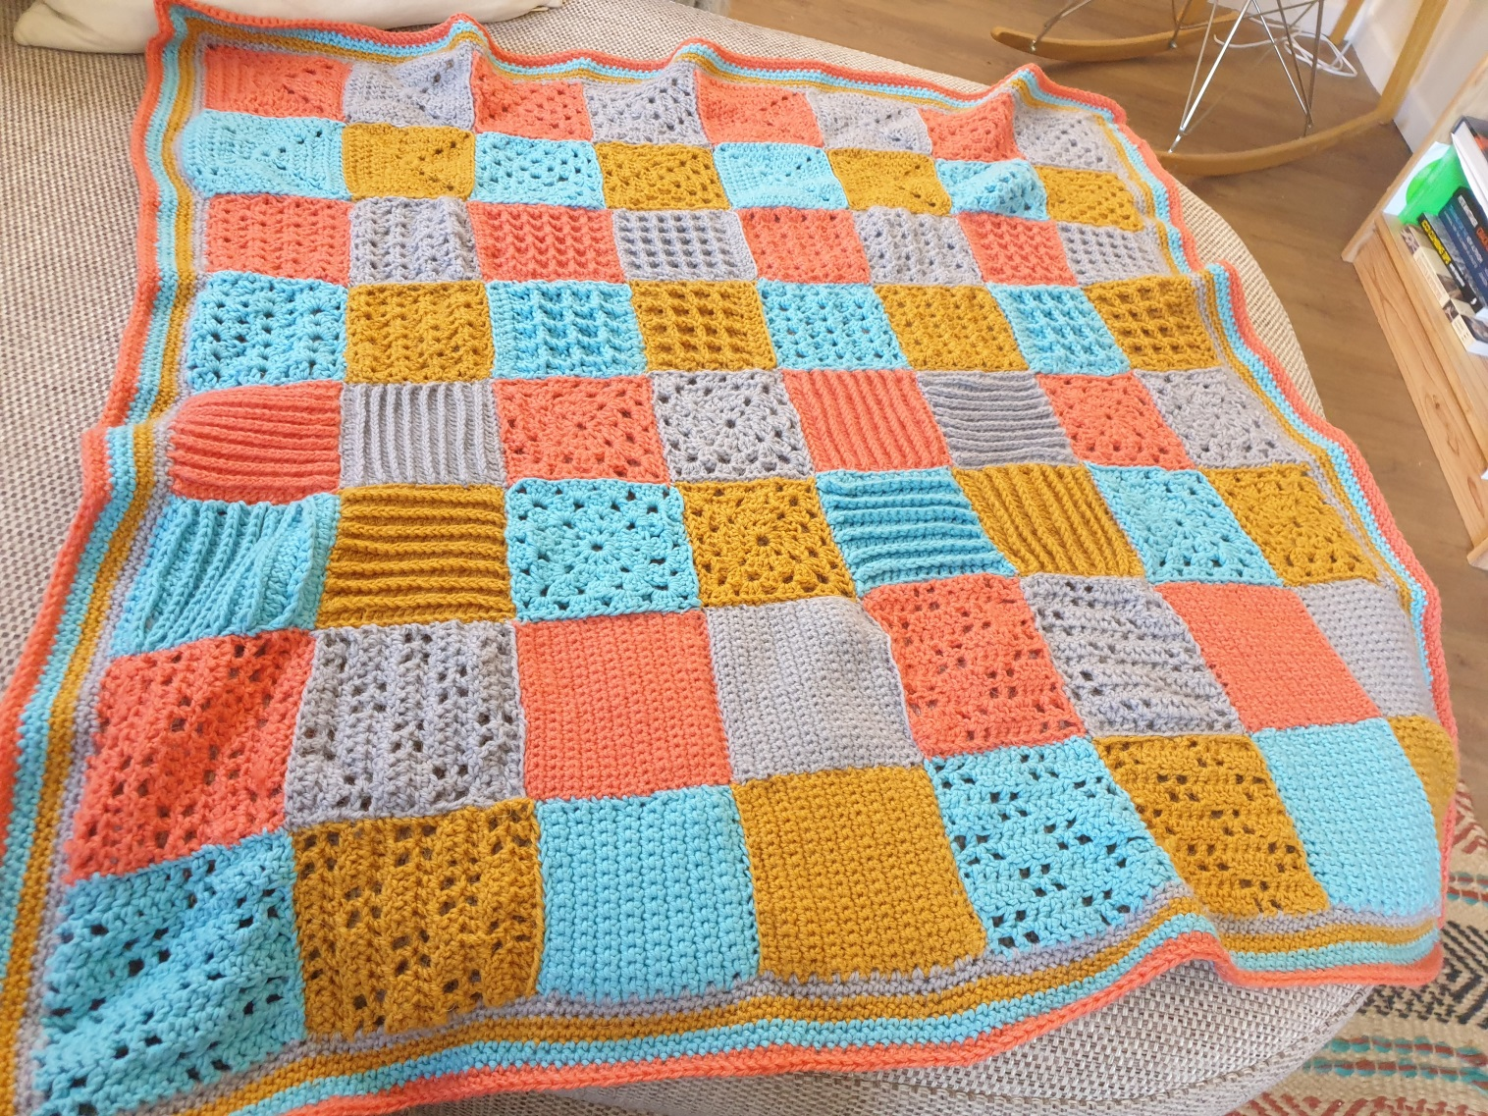
Lock down Blanket by Megan
Learning a new craft during lockdown has been a great relaxation technique for some and hopefully this shows with Megan’s gorgeous blanket .

Slide 31
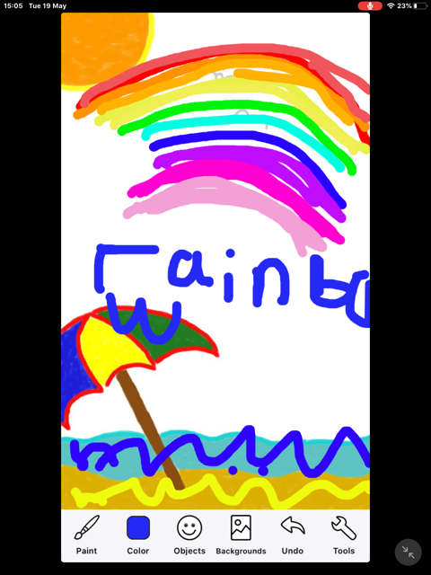
Rainbow 2 by Max
Using an app that he has on his iPad, Max created this scene based on his home.

Slide 32
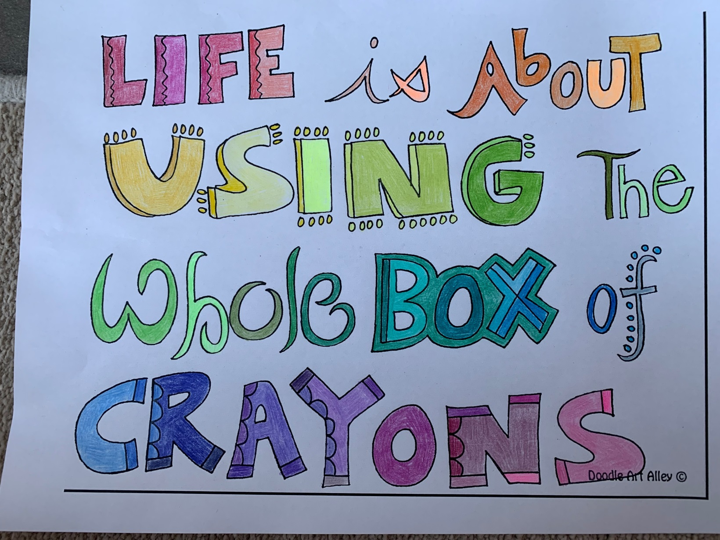
Whole box of Crayons by Mrs Pratt
As the staying goes “ Life is about using the whole box of crayons” in other words experience everything you can and try all. Variety in all things.

Slide 33
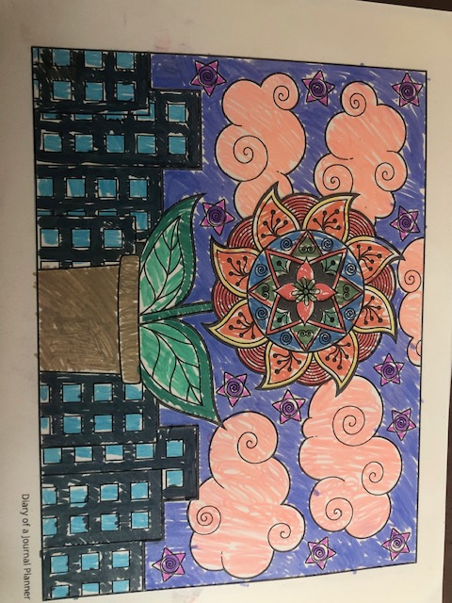
Flowers in a City by Amy
With a city background nature is taking over with this large flower in the foreground. Just like we are seeing.

Slide 34
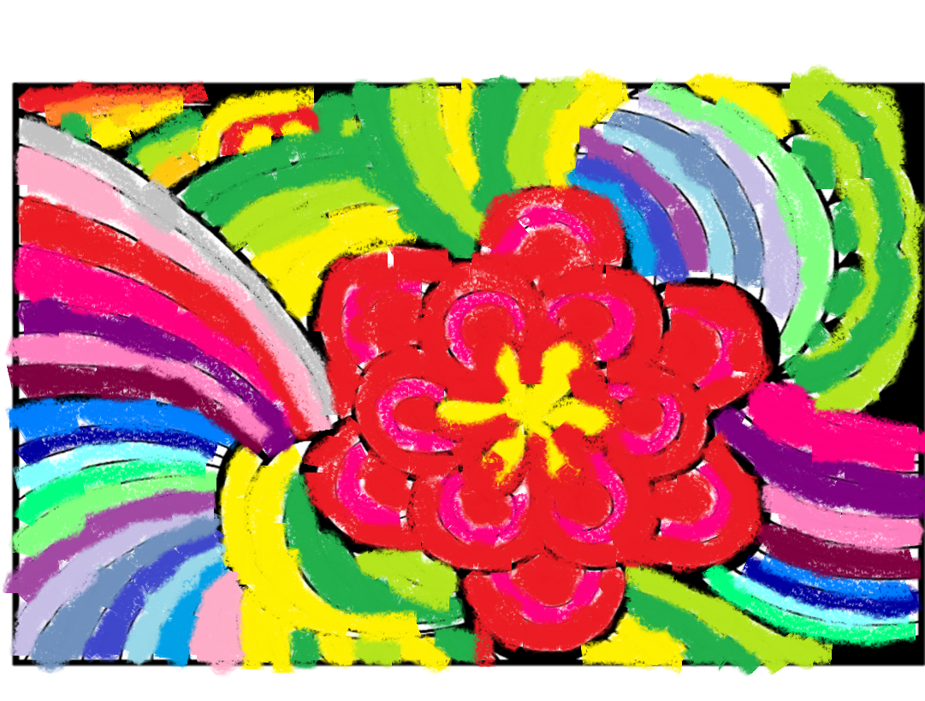
Flower Rainbow by Carys
Using paint to create an amazing flower design, a cheerful explosion of colour.

Slide 35
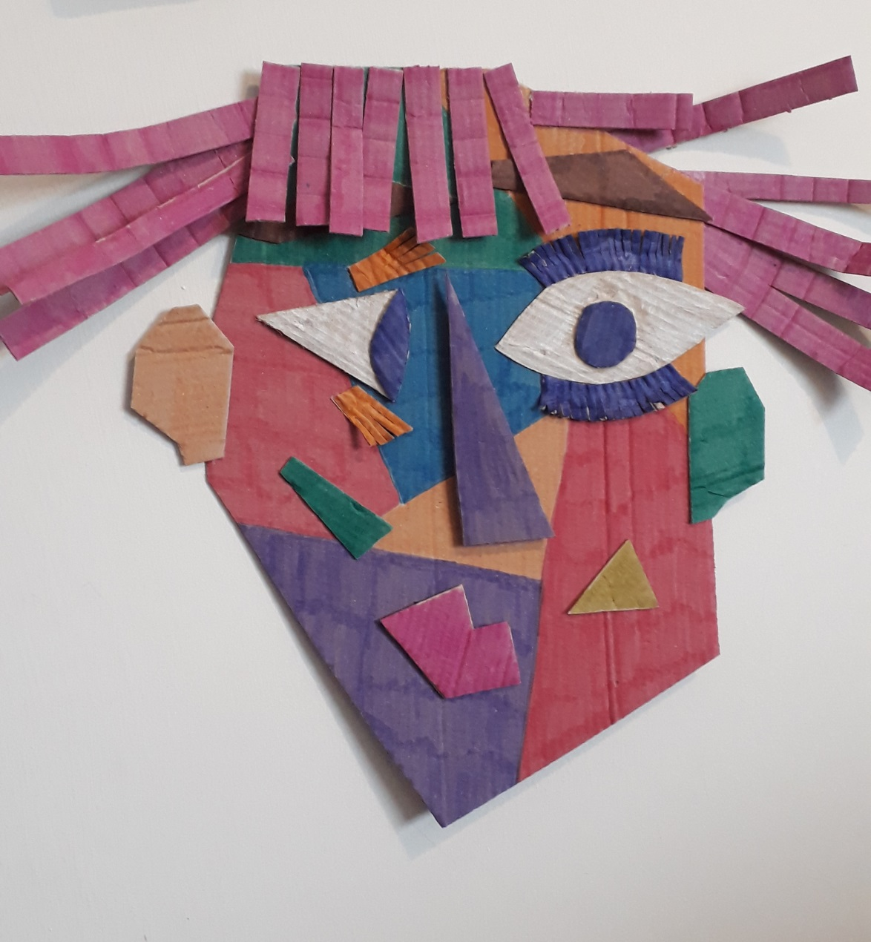
Picasso portrait by Mrs Kings
Using the card from an Amazon order and felt tip pens Mrs Kings created this cubist portrait. Some resemblance? Maybe.

Slide 36
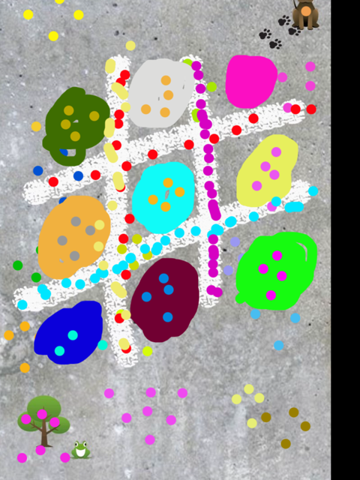
The Game by Max
This looks like a game of Noughts and Crosses but in colours.

Slide 37
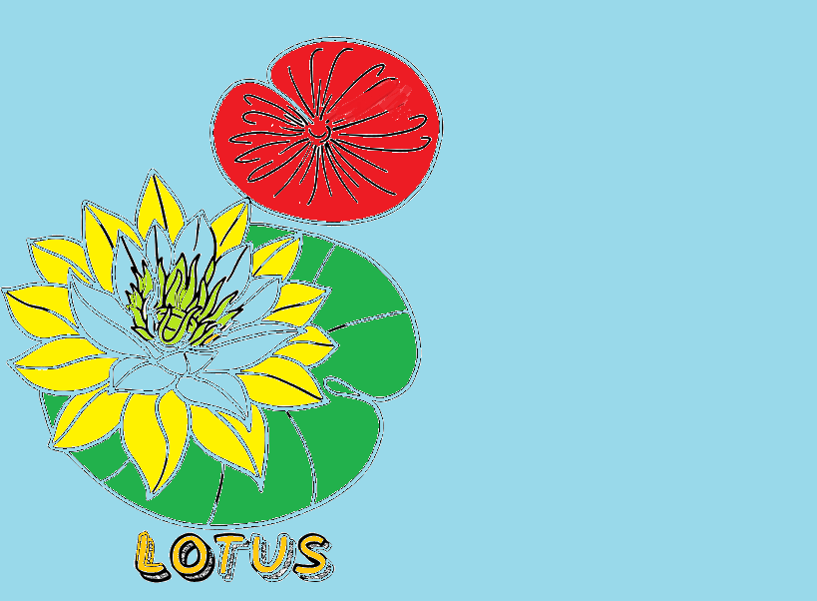
Lotus by Amy
Amy used Paint. Net for this stunning picture of a lotus floating on a pond.

Slide 38
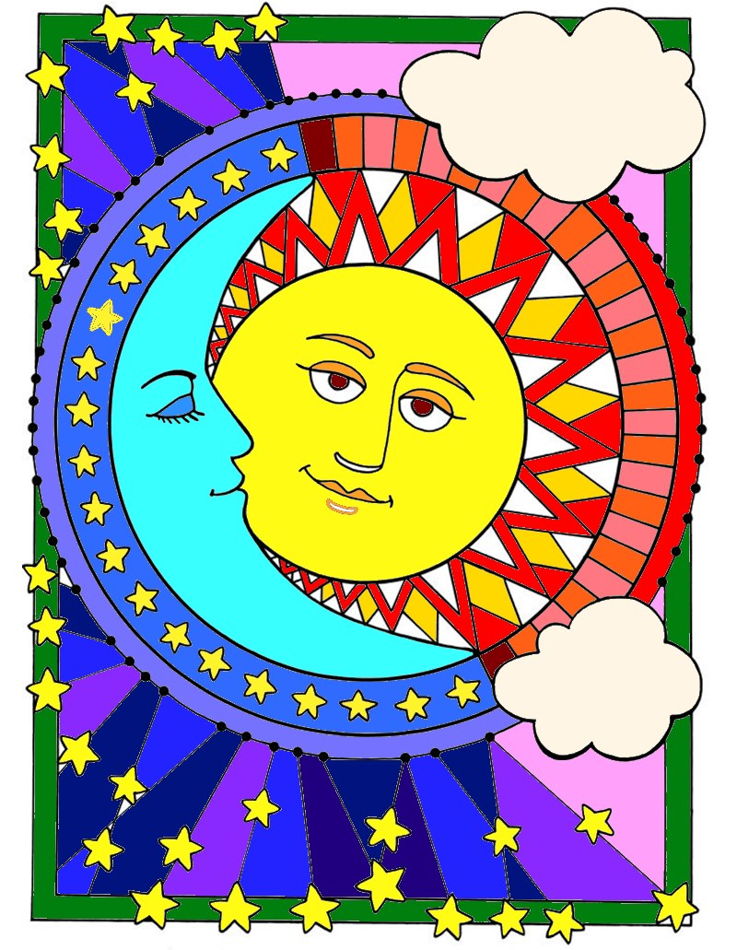
Day and Night
Using cool colours for night and warm colours for day this picture was created using Paint. Net.

Slide 39
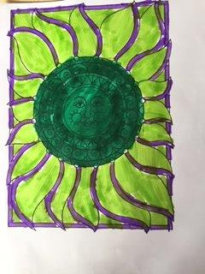
Glowing Sun by Carys
Green, yellow and purple have been used to create this ray of sunshine.

Slide 40
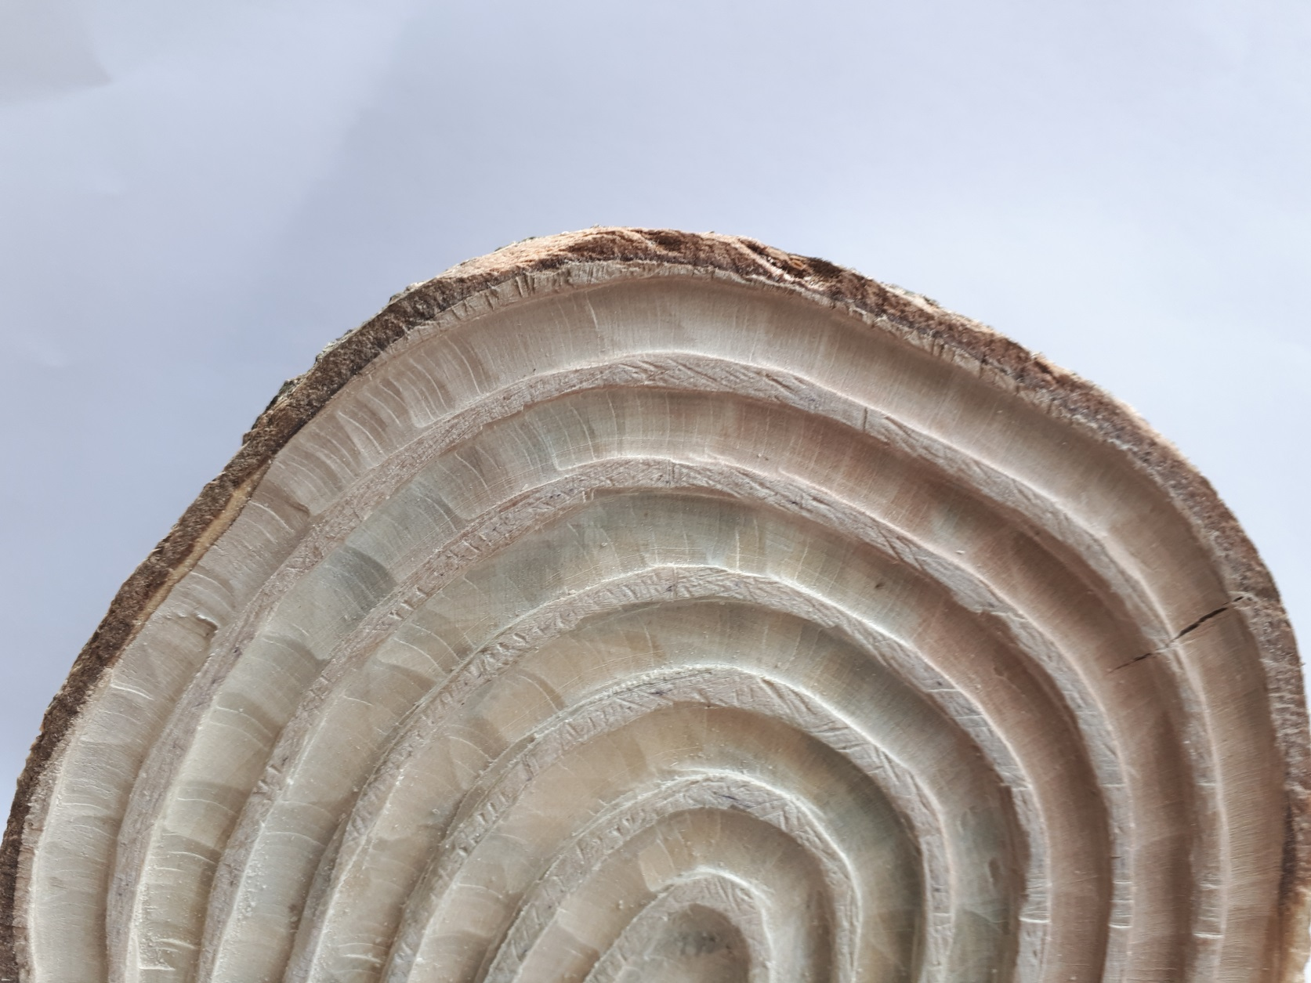
Rainbow in Wood by Mrs Ridley
This is spectacular, cutting into the bottom of a cut tree trunk. A lot of skill to get this so evenly cut. Wow!

Slide 41
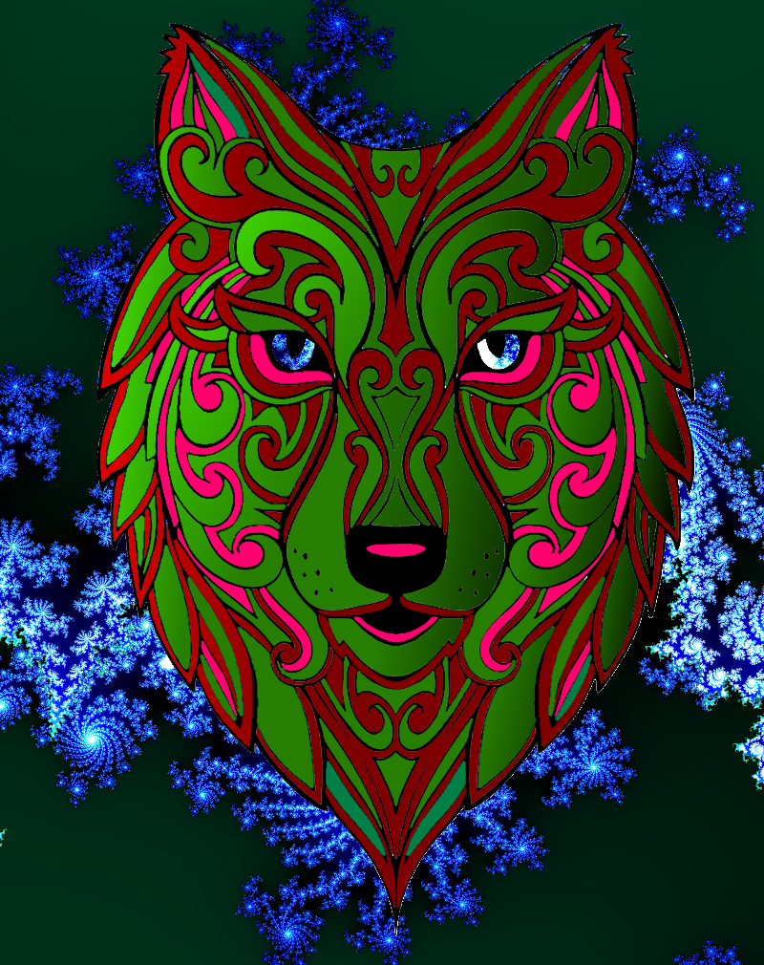
Wolf by Mr K Shaw
No not a manatee but a wolf from Mr Shaw . Very skilled use of Paint.Net to create this glowing wolf with atmospheric back ground. So realistic we can almost hear it howling.

Slide 42
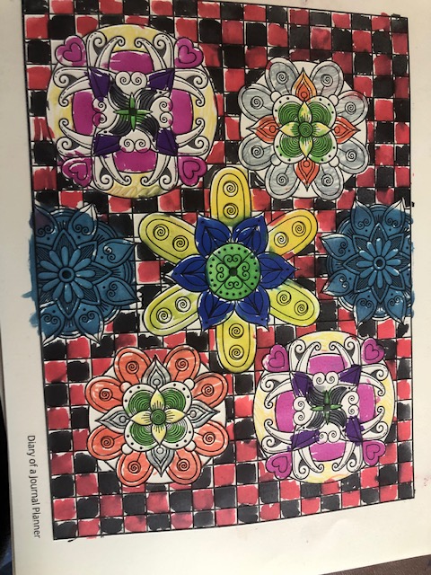
Pattern by Amy
A chequered board effect background with five flower mandalas placed around. Lots of colour in orange, pink, yellow and blue.

Slide 43
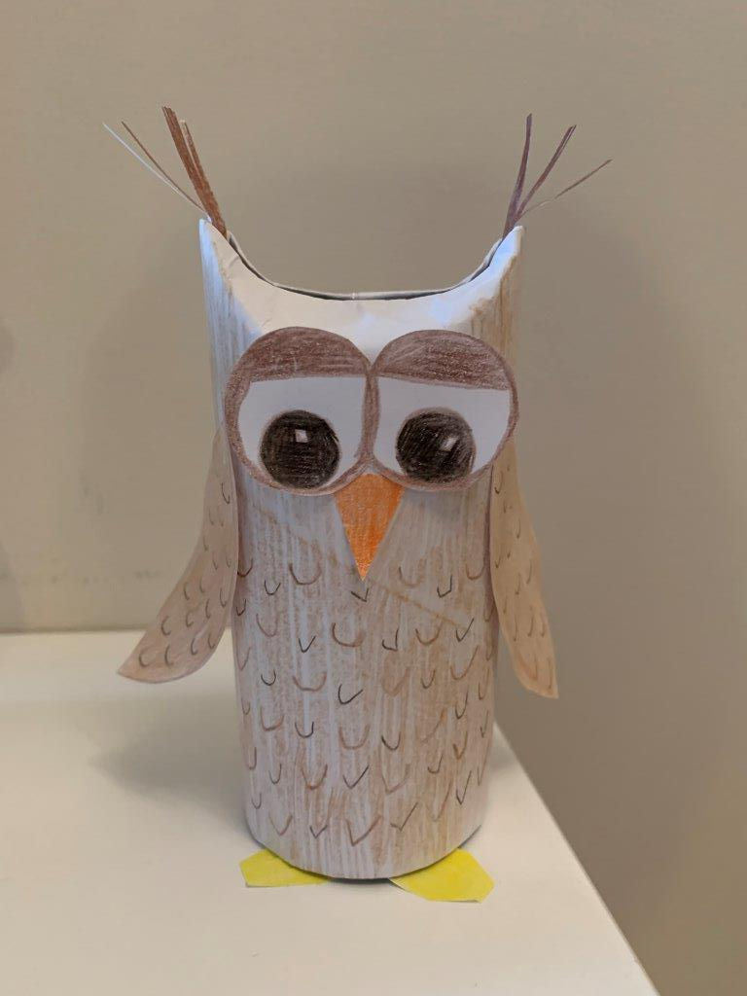
Shy Owl by Mrs Pratt
Using a Colour, Craft and Chat idea Mrs Pratt has created this little owl who seems very shy.

Slide 44
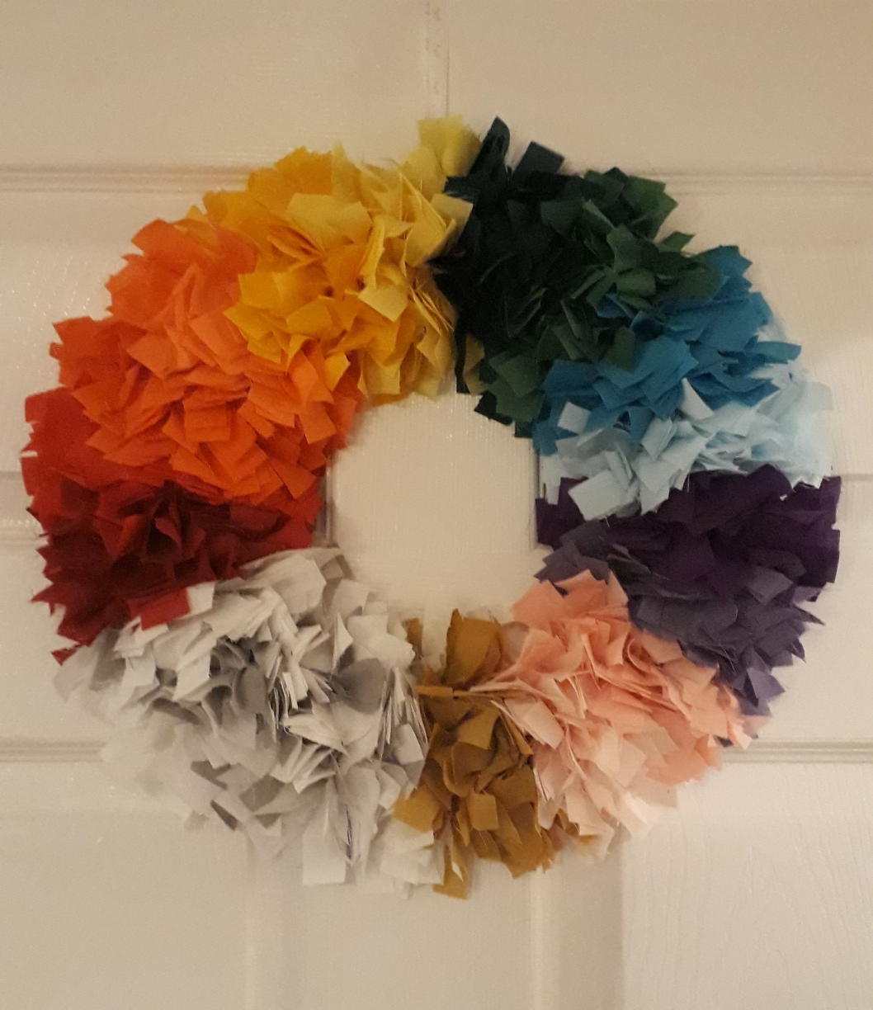
Rainbow Wreath by Mrs Kings
Created by using lots and lots of scraps of material cut into strips and tied to a wire ring starting with red and working round to white for the cloud and gold at the end of the rainbow.

Slide 45
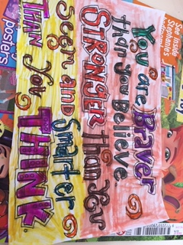
Quote by Carys
We totally believe this and think our students show this every day. “ You are braver than you believe, stronger than you seem and smarter than you think”.

Slide 46

You are amazing
This says it all, students and staff you really are absolutely amazing and have been over the last 12 weeks or more. Home schooling and joining in with all aspects of college life . Well done all.

